Slide 1


RAG based LLM model
Creating the QnA model using embeddings

Slide 2
Steps
Ensure prerequisites
Identify the knowledge base K
Setup the LLM with Langchain
Prompt testing
Create the vector DB using K
Add context to LLM
Prompt testing
Compare results

Slide 3
Prerequisites

Slide 5
Set up LLM

Slide 7
Create embeddings

Slide 8
Fine tuning vs embedding
 | Embedding | Fine-tuning
Definition | Use pre-trained LLM as feature extractor | Update parameters of pre-trained LLM during task-specific training
Process | Input Encoding - tokenized Embedding Extraction Downstream Task | Initialization Task-specific Training Fine-tuning Layers (optional)
Advantages | Efficient use of pre-trained knowledge Faster inference | Adaptability to task-specific nuances May require less labeled data than from scratch
Considerations | N/A | Risk of overfitting Computational cost can be high
When to use | Limited computational resources Limited labeled data | Significant computational resources Large corpus of labeled data
Performance | Performs well, especially with limited data | Can achieve state-of-the-art results on a wide range of tasks
Notes:
In embedding, you use the pre-trained LLM as a fixed feature extractor. Instead of adjusting the parameters of the LLM during training, you pass your input through the LLM, extract the contextualized embeddings (i.e., numerical representations of the input text), and then use these embeddings as input features for downstream tasks.
Input Encoding: Input text is tokenized and passed through the LLM.
Embedding Extraction: The output of the LLM's embedding layer is extracted for each token.
Downstream Task: These embeddings are then used as features for tasks like classification, named entity recognition, or sentiment analysis, typically with additional layers (e.g., a feedforward neural network) on top for task-specific processing.
In fine-tuning, you update the parameters of the pre-trained LLM during training on a task-specific dataset. This allows the model to adapt its representations to the specific characteristics of the task.
Initialization: Initialize the pre-trained LLM with its learned parameters.
Task-specific Training: Train the LLM on the downstream task data, adjusting its parameters via backpropagation and gradient descent.
Fine-tuning Layers: Optionally, you may fine-tune only specific layers of the LLM rather than the entire model.

Slide 9
In a nutshell
Embeddings models are typically small in size and less computationally intensive
Regular updates of embedding vectors are faster, cheaper, and simpler compared to fine-tuning a model.

Slide 10
Embeddings
External data undergoes conversion into embedding vectors via a distinct embeddings model.
Embeddings are a numerical representation of textual data – traditionally Word2Vec, BERT etc
These vectors are stored in a database for efficient access and utilization.
ToDo: Determine which text embedding approach we use from
MTEB Leaderboard - a Hugging Face Space by mteb

Slide 11
Benefits
The absence of fine-tuning requirement allows for flexibility.
Users can easily switch to a more powerful language model when available.
Alternatively, users can opt for a smaller, distilled version for faster inference if necessary.

Slide 12
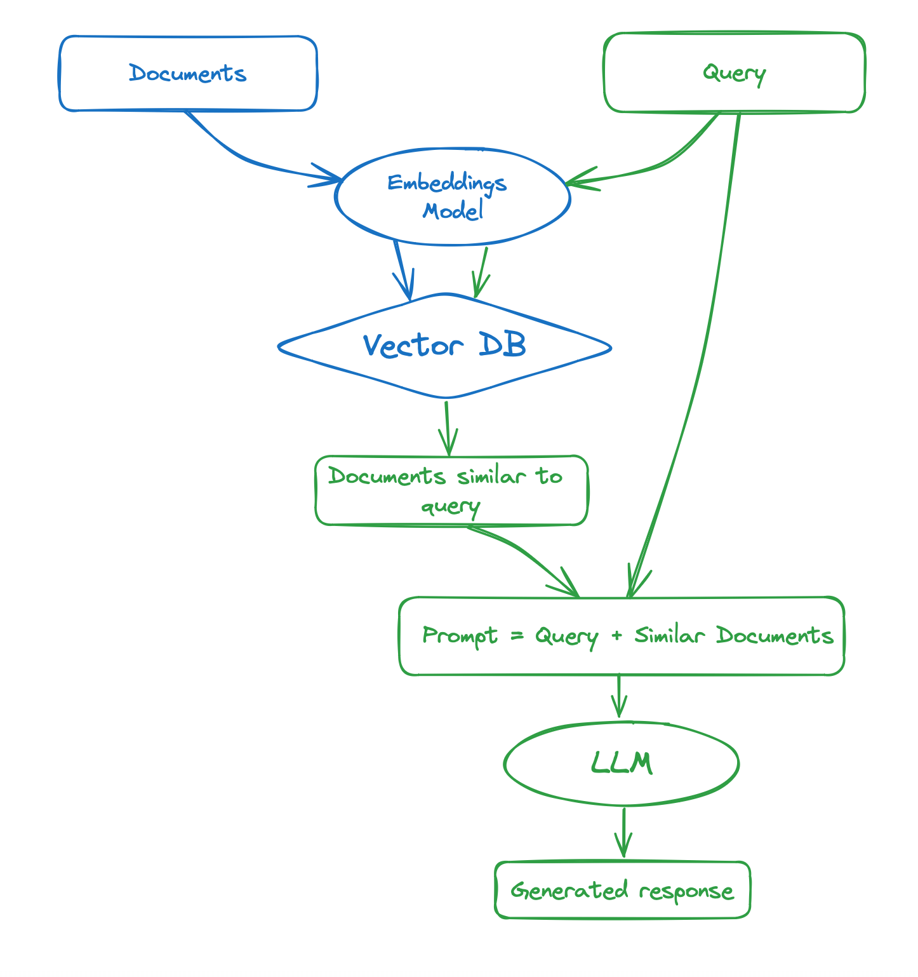
https://huggingface.co/learn/cookbook/rag_zephyr_langchain

Slide 13
Add context

Slide 14
Results

